Slide 1
EMSE 6586: Using Hashtags to Inform and Understand Influential Networks on Twitter
Emily Parrish
20 April 2021

Slide 2
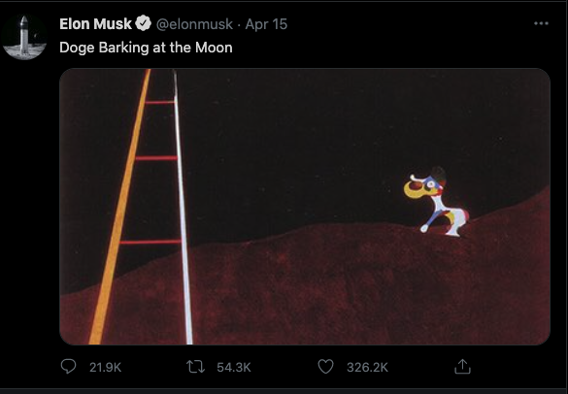
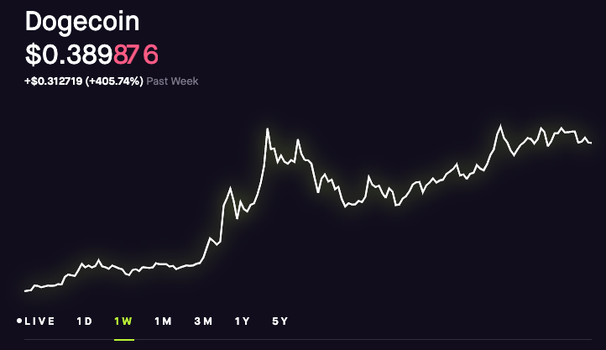
Social Media is a Game of Marketing and Metrics
Social media behavior indicates both very intentional and implicit indicators of interest or motive
Influencers and celebrities can have real-world impacts
Example: Dogecoin
Analytics Case Study: Elon Musk
Source: Twitter.com
Source: Robinhood.com
How can we use hashtags to identify topics of interest for Elon? And what are the impacts on his network?
Notes:
Whether you are meticulously curating content using hashtags to trigger the algorithms, or simply interacting with the topics you like on some social media platform, your data and interactions paint a unique picture of your online personality. And for celebrities and influencers, can have some larger implications and real-world impacts
In the last week, we witnessed a tangible example of this. Although Elon Musk does have some belief behind the success of the cryptocurrency Dogecoin, he uses his platform to occasionally tweet memes about it. On April 15, he posted such a tweet and similarly to past instances, the Dogecoin stock price jumped considerably.

Slide 3
Dataset and Databases
MongoDB (PyMongo)
Hashtag searching (hashtags were pre parsed)
Supporting helper functions to query additional info (like retweets for a specific user)
Arango (PyArango)
Graph Traversals
Network analysis (centrality, graph) density
Correlating users with statuses via topics

Slide 4
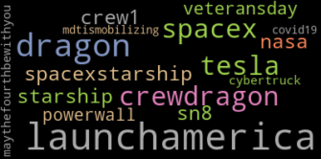
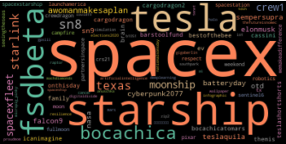
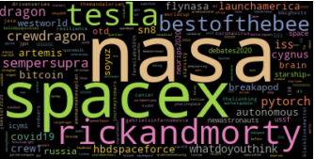
Preliminary Analysis: Hashtags
Elon’s Hashtags
Elon’s Favorite’s Hashtags
Elon’s Entire Network’s Hashtags
Top hashtags used by Elon:
#LaunchAmerica, #dragon
1.35% of favorited tweets with hashtag #tesla
3.21% of favorited tweets with #spacex
Queried MongoDB to look at hashtags specifically.
Notes:
We are working with Twitter data here, which is inherently self labelling! Using Mongo, I could easily leverage and query hashtags from various collections depending on our objectives and use simple metrics to characterize Elon’s tweeting behavior. For example, read slide above.
But how to we really leverage these hashtags to understand what topics are important to Elon and his network?

Slide 5
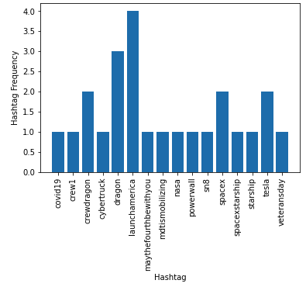
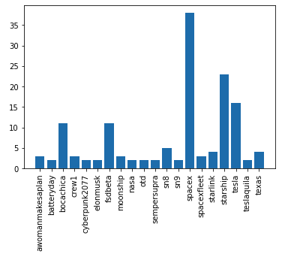
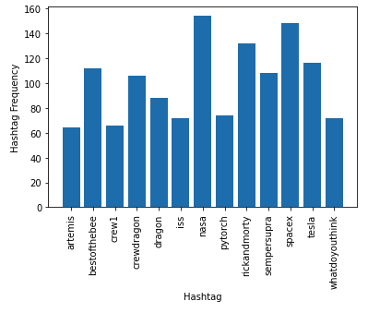
Preliminary Analysis: Hashtags
Elon’s Hashtags
Elon’s Favorite’s Hashtags
Elon’s Entire Network’s Hashtags
Gives insight into what Elon is subconsciously interested in based on favorites, or intentionally trying to promote via his own tweets (labelling with hashtags).
Notes:
Select three hashtags we see amongst all three groups: Elon’s, all of his friends, and all of his favorited status’

Slide 6
Querying the Network
PyArango leveraged for nested graph traversals
Search for users who reference our three key topics in their tweet activity
That Elon favorited
Backfilled edges to connect user relationships
Slow step, needs improvement!
FOR v,e,p IN 1..3 OUTBOUND ‘elon_id’ favorited
FILTER CONTAINS(v.text, ‘keyword’) == True
FOR status IN p.edges[*]._to
FOR v2,e2,p2 IN 1..2 INBOUND status tweeted
RETURN {"statuses_e": p.edges[*],
"statuses_v": p.vertices[*],
"users_e" : p2.edges[*],
"users_v" : p2.vertices[*]}
FOR friendship IN friends
FILTER friendship._from == ‘user_1’
FILTER friendship._to == ‘user_2’
RETURN friendship
Notes:
Then I queried arango .

Slide 7
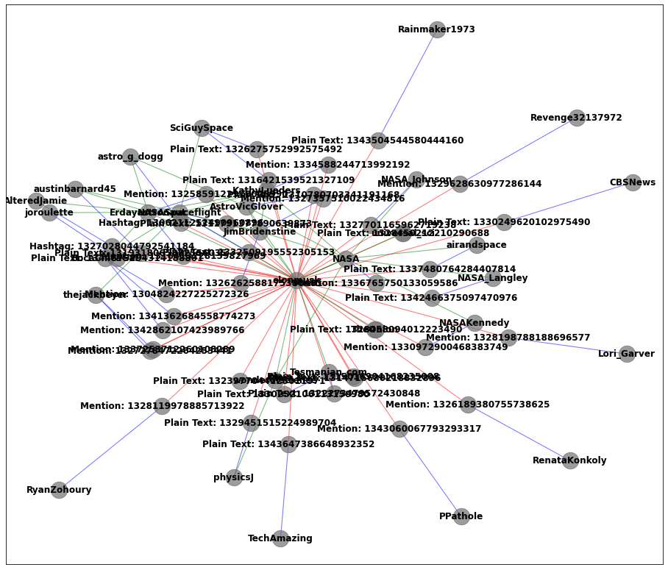
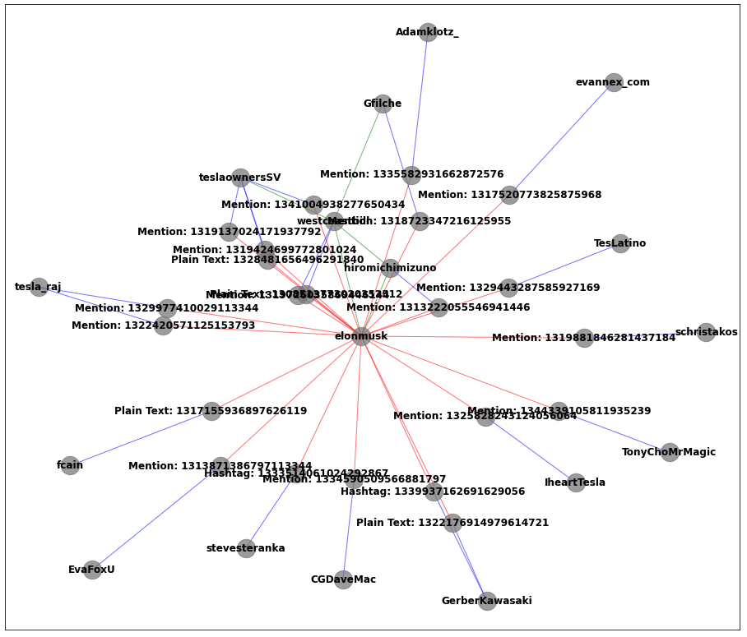
Analyzing the Network
NASA
tesla
Notes:
Blue = authors of these tweets
Red = statuses that were favorited by Elon
Green = follower relationships between
Mentions, Plain text, and Hashtag: Location of keyword in the status

Slide 8

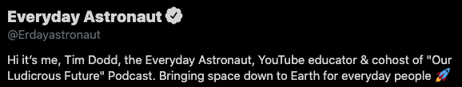

Influence Metrics
Keyword | Highest Degree Centrality | Engagement of Most Central | Graph Density | Percent Hashtags | Percent Mentions | Number of Connected Users
tesla | 'westcoastbill': 0.1578 | 1.352 | 0.0661 | 9% | 72.7% | 88
SpaceX | 'Erdayastronaut': 0.1076 | 4.2096 | 0.0142 | 16.4% | 31.8% | 302
NASA | 'Erdayastronaut': 0.1571 | 4.2096 | 0.0668 | 5% | 42.5% | 160
$$engagement=\frac{retweets+favorites}{\left(statuses+followers\right)∗v}$$
Elon seems to interact with (favorite) tweets where there are explicit mentions.
Notes:
Degree centrality: the number of ties that a node has. Here are the Highest degree of centrality users in the network.
Engagement: calculation of how many people interact directly with that user. Based off of the highest degree of centrality users. Variable v is a factor of 1 if a user is not verified and 1.10 if they are.
Density is really giving us a measure of how many members of the network are friends with each other, not just the number but it characterizes the interconnectivity
Percent Hashtags and Percent Mentions: number of status nodes that upon identification, the keyword was part of a mention or a hashtag rather than plain text.
Number of Connected Users: Number of edges between favorited users (by Elon) within the network.
So based on these three topics, Elon seems to interact with (favorite) tweets where the keyword is part of the handle and

Slide 9
Conclusions/Future Work
Could extrapolate this methodology to users in the dataset beyond those who Elon interacts with? Are his followers disseminating tweets in the same way as he is?
By extension, is there another user who is more impactful in the broader network specifically when tweeting about these topics?
Add mentioned to type of edge collections and use replies and mentions to factor into engagement metrics.
Additional metrics!
True Engagement, but you need to know how many encountered
Engagement with posts, not just users
Reach of an individual based on followers

Slide 10
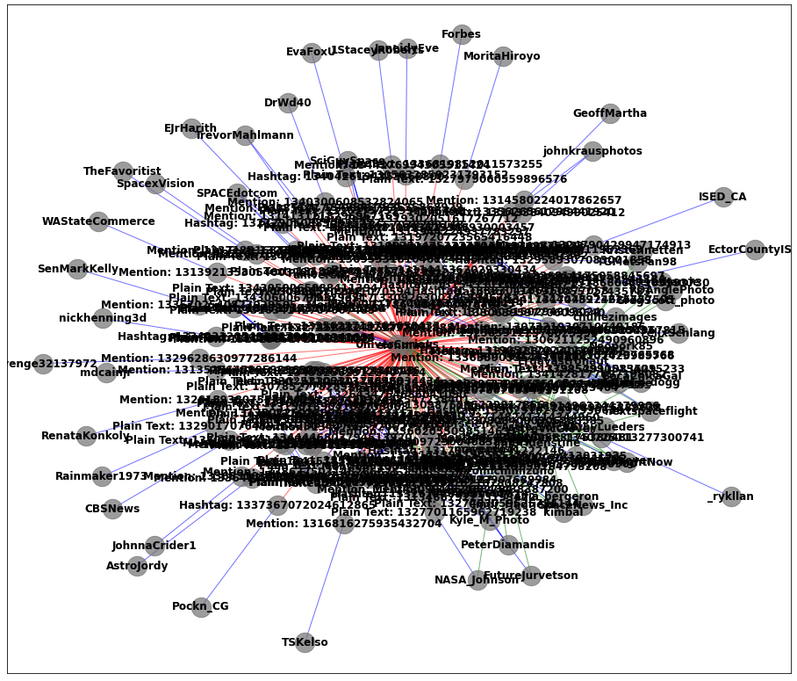
Backup
SpaceX

